Slide 1

Join Operation in DBMS

Slide 2
এই Lesson এ কি শিখব?
What is Join?
Cross Product?
Inner Join
Left Join
Right Join
Full join

Slide 3
Join Operation in DBMS
It is used to combine two or more tables based on column having similar values.
Join indicates joining two or more tables. Data is fetched from two or more tables based on some conditions.
It is denoted by ⋈.

Slide 4
Natural Join
A NATURAL JOIN is a JOIN operation that creates an implicit join clause for you based on the common columns in the two tables being joined.
Common columns are columns that have the same name in both tables. A NATURAL JOIN can be an INNER join, a LEFT OUTER join, or a RIGHT OUTER join. The default is INNER join.
Join= Cross Product + Condition

Slide 5
Cross Product
EMP (4 rows)
E_No | E_Name | Address
1 | Intia | Mirpur
2 | Bintia | Shamoli
3 | Sintia | Dhanmondi
4 | Mintia | Motijheel
E_No | E_Name | Address | Dept_No | Name | E_No
1 | Intia | Mirpur | D1 | HR | 1
1 | Intia | Mirpur | D2 | IT | 2
1 | Intia | Mirpur | D3 | MRKT | 4
2 | Bintia | Shamoli | D1 | HR | 1
2 | Bintia | Shamoli | D2 | IT | 2
2 | Bintia | Shamoli | D3 | MRKT | 4
3 | Sintia | Dhanmondi | D1 | HR | 1
3 | Sintia | Dhanmondi | D2 | IT | 2
3 | Sintia | Dhanmondi | D3 | MRKT | 4
4 | Mintia | Motijheel | D1 | HR | 1
4 | Mintia | Motijheel | D2 | IT | 2
4 | Mintia | Motijheel | D3 | MRKT | 4
Dept (3 rows)
Dept_No | Name | E_No
D1 | HR | 1
D2 | IT | 2
D3 | MRKT | 4

Slide 6
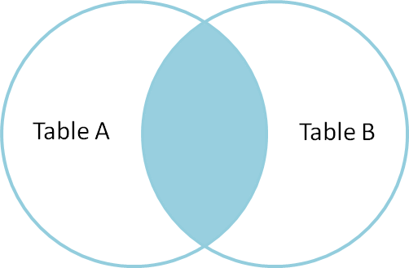
Inner Join
E_No | E_Name | Address | Dept_No | Name | E_No
1 | Intia | Mirpur | D1 | HR | 1
1 | Intia | Mirpur | D2 | IT | 2
1 | Intia | Mirpur | D3 | MRKT | 4
2 | Bintia | Shamoli | D1 | HR | 1
2 | Bintia | Shamoli | D2 | IT | 2
2 | Bintia | Shamoli | D3 | MRKT | 4
3 | Sintia | Dhanmondi | D1 | HR | 1
3 | Sintia | Dhanmondi | D2 | IT | 2
3 | Sintia | Dhanmondi | D3 | MRKT | 4
4 | Mintia | Motijheel | D1 | HR | 1
4 | Mintia | Motijheel | D2 | IT | 2
4 | Mintia | Motijheel | D3 | MRKT | 4
Query: Find the emp names who is working in a department
-> select E_Name from EMP, Dept where EMP. E_No= Dept. E_No

Slide 7
SELECT table1.column1,table1.column2,table2.column1,....
FROM table1
INNER JOIN table2
ON table1.matching_column = table2.matching_column;

Slide 8
Equi Join
Find the employee name who worked in a department having location same as their address.
-> select E_Name from EMP, Dept where EMP. E_No= Dept. E_No and EMP. address= Dept. Location
EMP
E_No | E_Name | Address | Dept_No | Name | E_No
1 | Intia | Motijheel | D1 | Motijheel | 1
1 | Intia | Motijheel | D2 | Shamoli | 2
1 | Intia | Motijheel | D3 | Mirpur | 4
2 | Bintia | Shamoli | D1 | Motijheel | 1
2 | Bintia | Shamoli | D2 | Shamoli | 2
2 | Bintia | Shamoli | D3 | Mirpur | 4
3 | Sintia | Shamoli | D1 | Motijheel | 1
3 | Sintia | Shamoli | D2 | Shamoli | 2
3 | Sintia | Shamoli | D3 | Mirpur | 4
4 | Mintia | Motijheel | D1 | Motijheel | 1
4 | Mintia | Motijheel | D2 | Shamoli | 2
4 | Mintia | Motijheel | D3 | Mirpur | 4
E_No | E_Name | Address
1 | Intia | Motijheel
2 | Bintia | Shamoli
3 | Sintia | Shamoli
4 | Mintia | Motijheel
Dept
Dept_No | Location | E_No
D1 | Motijheel | 1
D2 | Shamoli | 2
D3 | Mirpur | 4

Slide 9
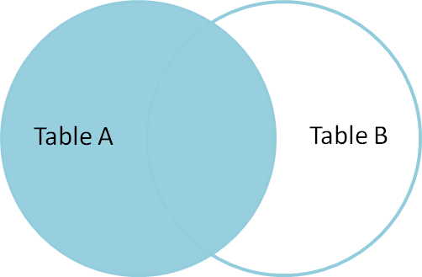
Left Join
This join returns all the rows of the table on the left side of the join and matching rows for the table on the right side of join.
The rows for which there is no matching row on right side, the result-set will contain null.
LEFT JOIN is also known as LEFT OUTER JOIN
SELECT table1.column1,table1.column2,table2.column1,....
FROM table1
LEFT JOIN table2
ON table1.matching_column = table2.matching_column;

Slide 10
Left Join Example
EMPLOYEE
FACT_WORKERS
EMP_NAME | STREET | CITY
Ram | Civil line | Mumbai
Shyam | Park street | Kolkata
Ravi | M.G. Street | Delhi
Hari | Nehru nagar | Hyderabad
EMP_NAME | BRANCH | SALARY
Ram | Infosys | 10000
Shyam | Wipro | 20000
Kuber | HCL | 30000
Hari | TCS | 50000
EMPLOYEE ⟕ FACT_WORKERS
EMP_NAME | STREET | CITY | BRANCH | SALARY
Ram | Civil line | Mumbai | Infosys | 10000
Shyam | Park street | Kolkata | Wipro | 20000
Hari | Nehru street | Hyderabad | TCS | 50000
Ravi | M.G. Street | Delhi | NULL | NULL

Slide 11
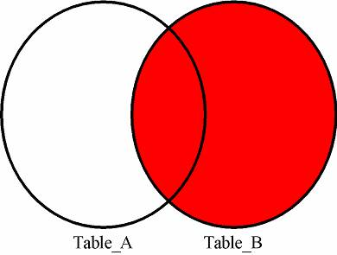
Right Join
RIGHT JOIN is similar to LEFT JOIN. This join returns all the rows of the table on the right side of the join and matching rows for the table on the left side of join.
The rows for which there is no matching row on left side, the result-set will contain null.
RIGHT JOIN is also known as RIGHT OUTER JOIN
SELECT table1.column1,table1.column2,table2.column1,....
FROM table1
RIGHT JOIN table2
ON table1.matching_column = table2.matching_column;

Slide 12
Right Join Example
EMPLOYEE
FACT_WORKERS
EMP_NAME | STREET | CITY
Ram | Civil line | Mumbai
Shyam | Park street | Kolkata
Ravi | M.G. Street | Delhi
Hari | Nehru nagar | Hyderabad
EMP_NAME | BRANCH | SALARY
Ram | Infosys | 10000
Shyam | Wipro | 20000
Kuber | HCL | 30000
Hari | TCS | 50000
EMPLOYEE ⟖ FACT_WORKERS
EMP_NAME | BRANCH | SALARY | STREET | CITY
Ram | Infosys | 10000 | Civil line | Mumbai
Shyam | Wipro | 20000 | Park street | Kolkata
Hari | TCS | 50000 | Nehru street | Hyderabad
Kuber | HCL | 30000 | NULL | NULL

Slide 13
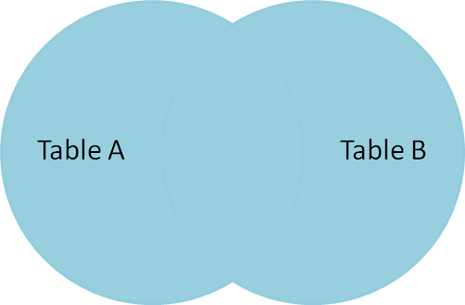
Full Outer Join
FULL JOIN creates the result-set by combining result of both LEFT JOIN and RIGHT JOIN.
The result-set will contain all the rows from both the tables. The rows for which there is no matching, the result-set will contain NULL values.
SELECT table1.column1,table1.column2,table2.column1,....
FROM table1
FULL JOIN table2
ON table1.matching_column = table2.matching_column;

Slide 14
Full Join Example
EMPLOYEE
FACT_WORKERS
EMP_NAME | STREET | CITY
Ram | Civil line | Mumbai
Shyam | Park street | Kolkata
Ravi | M.G. Street | Delhi
Hari | Nehru nagar | Hyderabad
EMP_NAME | BRANCH | SALARY
Ram | Infosys | 10000
Shyam | Wipro | 20000
Kuber | HCL | 30000
Hari | TCS | 50000
EMPLOYEE ⟗ FACT_WORKERS
EMP_NAME | STREET | CITY | BRANCH | SALARY
Ram | Civil line | Mumbai | Infosys | 10000
Shyam | Park street | Kolkata | Wipro | 20000
Hari | Nehru street | Hyderabad | TCS | 50000
Ravi | M.G. Street | Delhi | NULL | NULL
Kuber | NULL | NULL | HCL | 30000

Slide 15
“Start where you are. Use what you have. Do what you can.”
– – Arthur Ashe

